Slide 1
COT5615: Math for Intelligent Systems I
Anand Rangarajan
Lecture 33

Slide 2
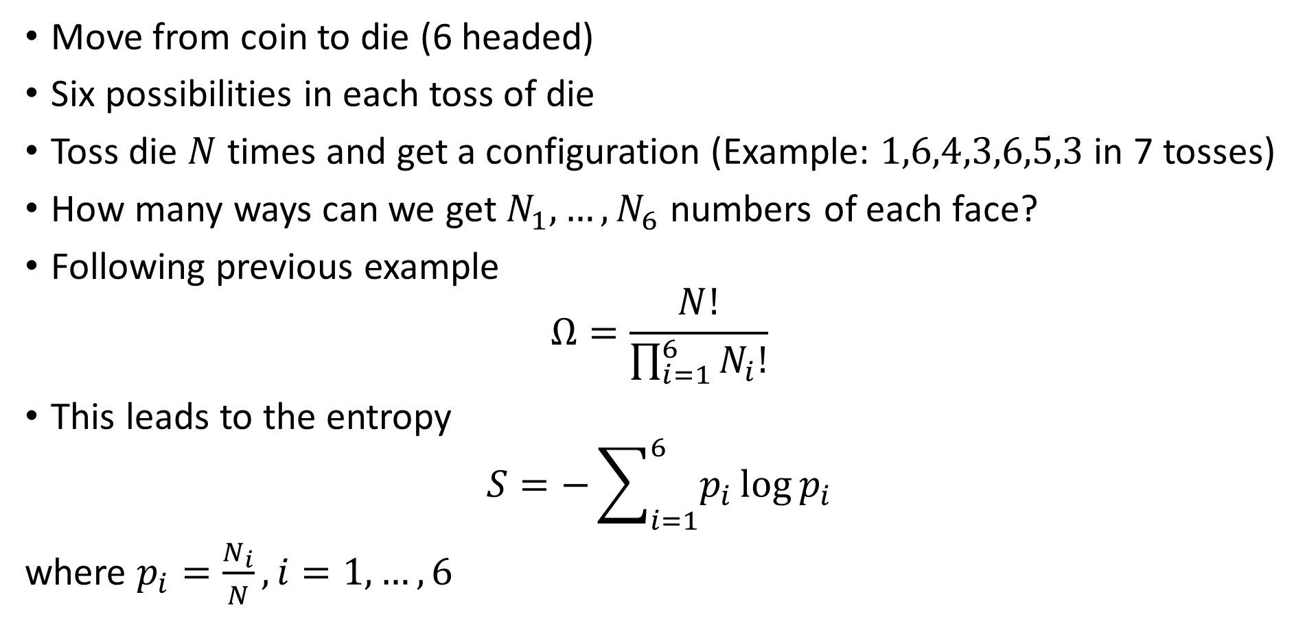
Discrete Distributions
Move from coin to die (6 headed)
Six possibilities in each toss of die
Toss die $N$ times and get a configuration (Example: $1,6,4,3,6,5,3$ in 7 tosses)
How many ways can we get $N_{1},…,N_{6}$ numbers of each face?
Following previous example
$$Ω=\frac{N!}{\prod_{i=1}^{6}{N_{i}!}}$$
This leads to the entropy
$$S=−\sum_{i=1}^{6}{p_{i}}\log{p_{i}}$$
where $p_{i}=\frac{N_{i}}{N},i=1,…,6$

Slide 3
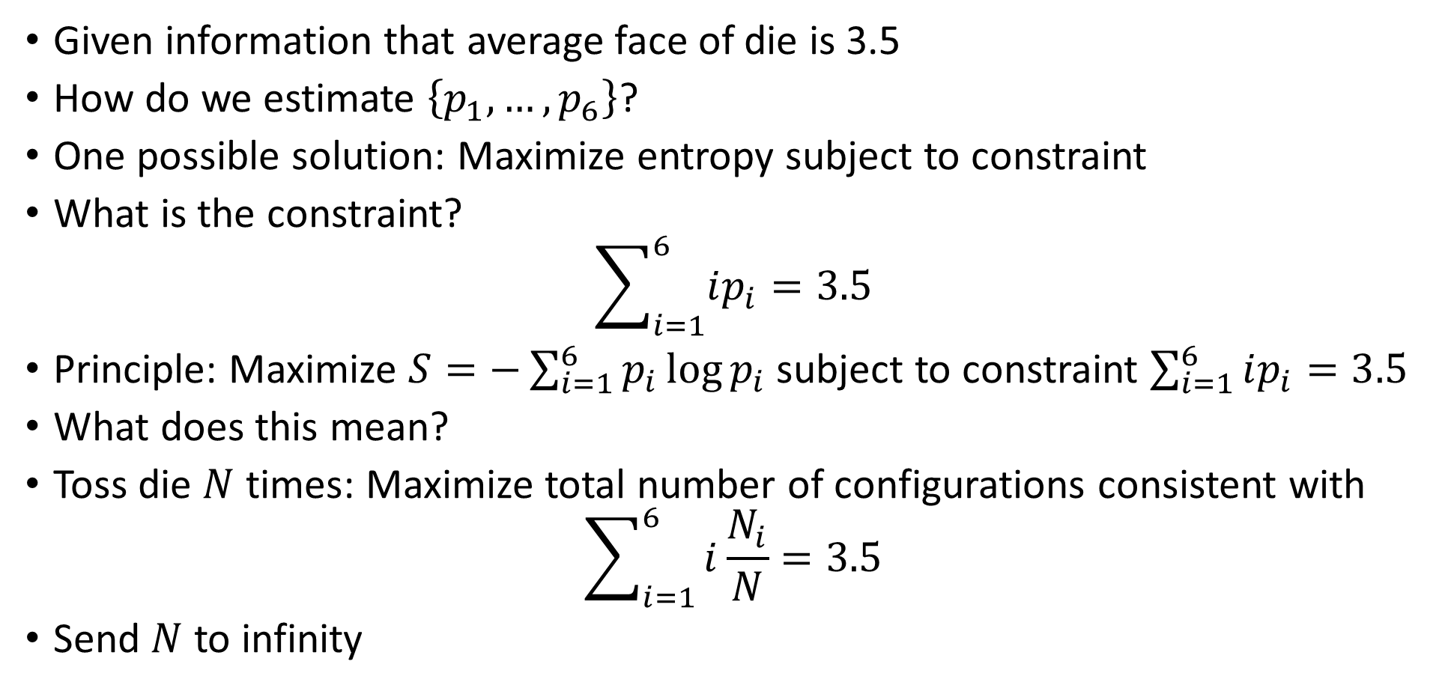
Macroscopic Constraints
Given information that average face of die is 3.5
How do we estimate $\left\{p_{1},…,p_{6}\right\}$?
One possible solution: Maximize entropy subject to constraint
What is the constraint?
$$\sum_{i=1}^{6}{ip_{i}=3.5}$$
Principle: Maximize $S=−\sum_{i=1}^{6}{p_{i}}\log{p_{i}}$ subject to constraint $\sum_{i=1}^{6}{ip_{i}=3.5}$
What does this mean?
Toss die $N$ times: Maximize total number of configurations consistent with
$$\sum_{i=1}^{6}{i\frac{N_{i}}{N}=3.5}$$
Send $N$ to infinity

Slide 4
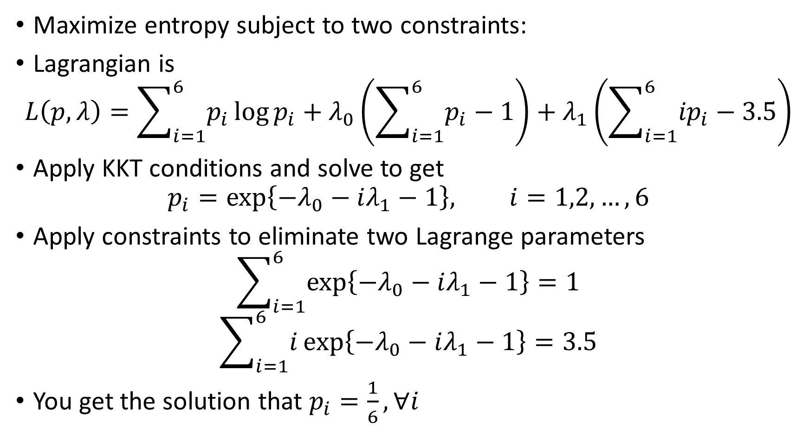
Lagrangian for Macroscopic Constraints
Maximize entropy subject to two constraints:
Lagrangian is
$$L\left(p,λ\right)=\sum_{i=1}^{6}{p_{i}}\log{p_{i}}+λ_{0}\left(\sum_{i=1}^{6}{p_{i}}−1\right)+λ_{1}\left(\sum_{i=1}^{6}{{ip}_{i}}−3.5\right)$$
Apply KKT conditions and solve to get
$$p_{i}=\exp\left\{−λ_{0}−iλ_{1}−1\right\}, i=1,2,…,6$$
Apply constraints to eliminate two Lagrange parameters
$$\sum_{i=1}^{6}{\exp\left\{−λ_{0}−iλ_{1}−1\right\}}=1$$
$$\sum_{i=1}^{6}{i\exp\left\{−λ_{0}−iλ_{1}−1\right\}}=3.5$$
You get the solution that $p_{i}=\frac{1}{6}, ∀i$

Slide 5
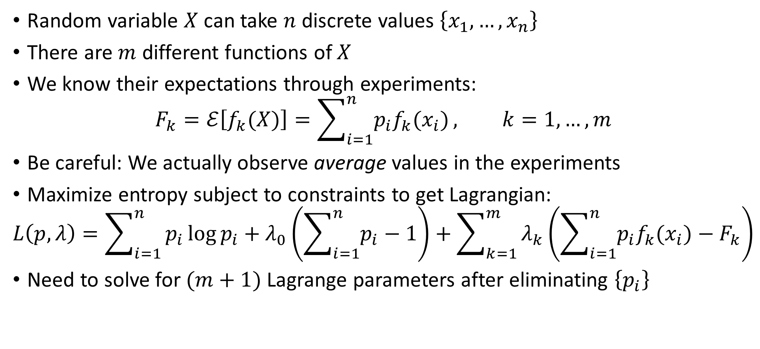
Generalization
Random variable $X$ can take $n$ discrete values $\left\{x_{1},…,x_{n}\right\}$
There are $m$ different functions of $X$
We know their expectations through experiments:
$$F_{k}=ℰ\left[f_{k}(X)\right]=\sum_{i=1}^{n}{p_{i}f_{k}(x_{i})}, k=1,…,m$$
Be careful: We actually observe average values in the experiments
Maximize entropy subject to constraints to get Lagrangian:
$$L\left(p,λ\right)=\sum_{i=1}^{n}{p_{i}\log{p_{i}}+λ_{0}\left(\sum_{i=1}^{n}{p_{i}}−1\right)+\sum_{k=1}^{m}{λ_{k}\left(\sum_{i=1}^{n}{p_{i}f_{k}(x_{i})}−F_{k}\right)}}$$
Need to solve for $(m+1)$ Lagrange parameters after eliminating $\left\{p_{i}\right\}$

Slide 6
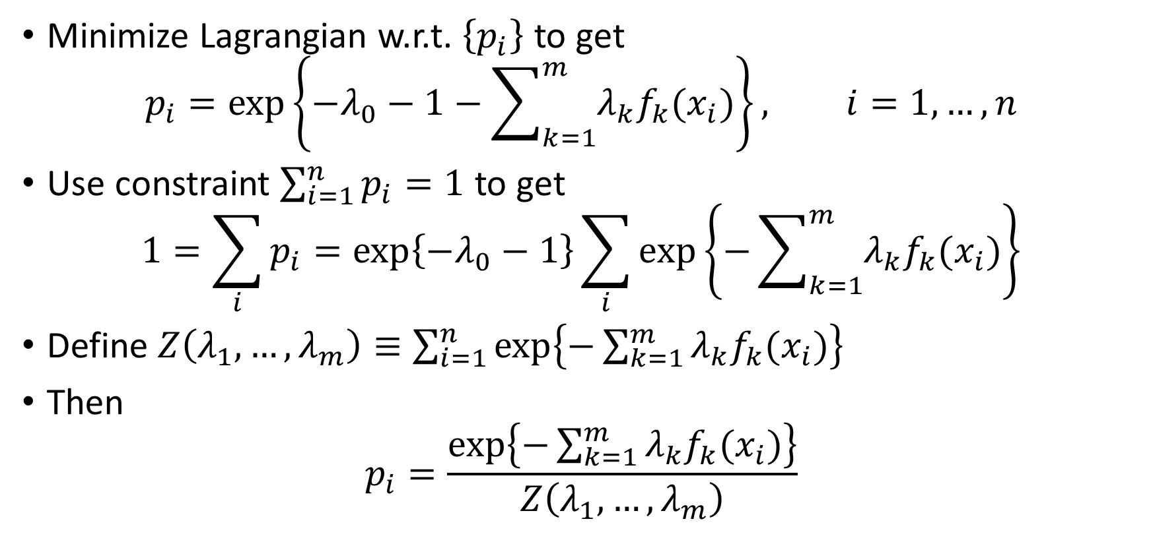
The Gibbs Distribution Redux
Minimize Lagrangian w.r.t. $\left\{p_{i}\right\}$ to get
$$p_{i}=\exp\left\{{−λ}_{0}−1−\sum_{k=1}^{m}{λ_{k}f_{k}(x_{i})}\right\}, i=1,…,n$$
Use constraint $\sum_{i=1}^{n}{p_{i}}=1$ to get
$$1=\sum_{i}{p_{i}}=\exp\left\{−λ_{0}−1\right\}\sum_{i}{\exp\left\{−\sum_{k=1}^{m}{λ_{k}f_{k}(x_{i})}\right\}}$$
Define $Z\left(λ_{1},…,λ_{m}\right)≡\sum_{i=1}^{n}{\exp\left\{−\sum_{k=1}^{m}{λ_{k}f_{k}(x_{i})}\right\}}$
Then
$$p_{i}=\frac{\exp\left\{−\sum_{k=1}^{m}{λ_{k}f_{k}(x_{i})}\right\}}{Z\left(λ_{1},…,λ_{m}\right)}$$

Slide 7
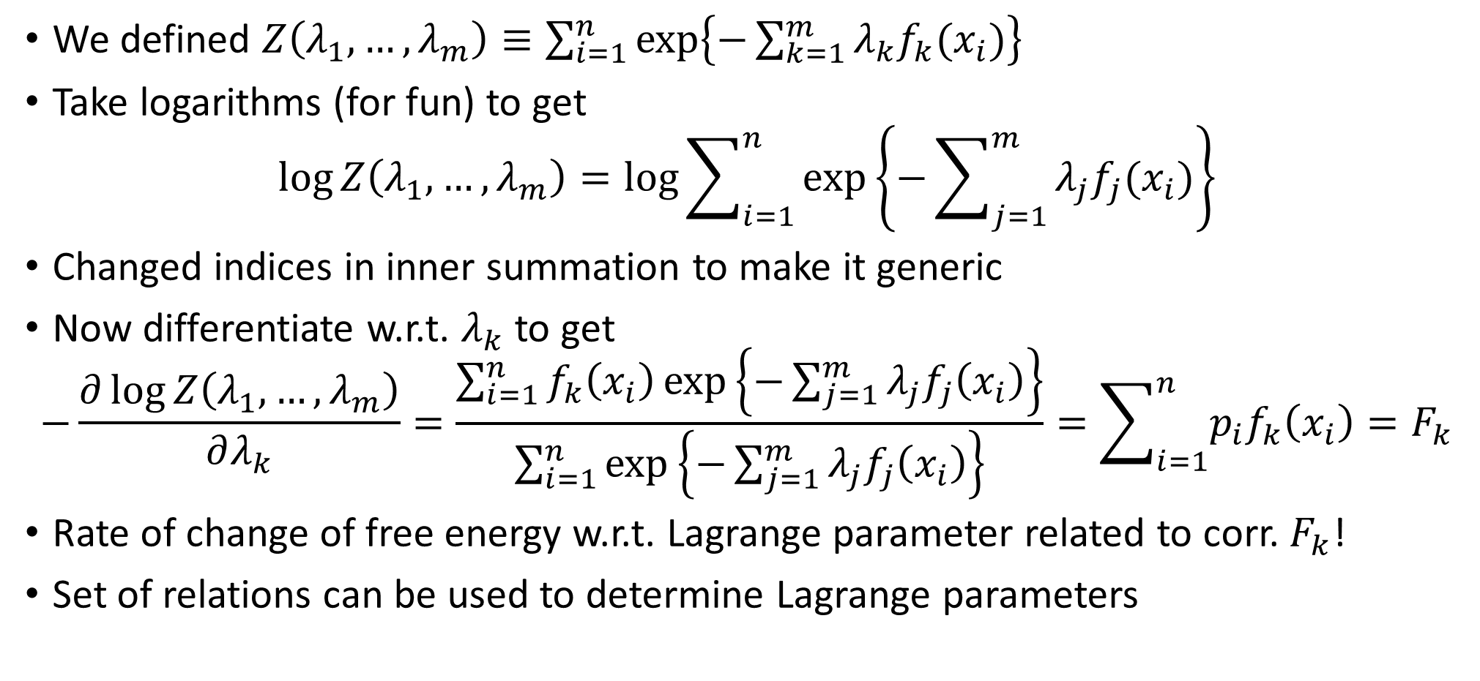
Lagrange Parameters Relation
We defined $Z\left(λ_{1},…,λ_{m}\right)≡\sum_{i=1}^{n}{\exp\left\{−\sum_{k=1}^{m}{λ_{k}f_{k}(x_{i})}\right\}}$
Take logarithms (for fun) to get
$$\log{Z\left(λ_{1},…,λ_{m}\right)=\log{\sum_{i=1}^{n}{\exp\left\{−\sum_{j=1}^{m}{λ_{j}f_{j}(x_{i})}\right\}}}}$$
Changed indices in inner summation to make it generic
Now differentiate w.r.t. $λ_{k}$ to get
$$−\frac{∂\log{Z\left(λ_{1},…,λ_{m}\right)}}{∂λ_{k}}=\frac{\sum_{i=1}^{n}{f_{k}\left(x_{i}\right)\exp\left\{−\sum_{j=1}^{m}{λ_{j}f_{j}\left(x_{i}\right)}\right\}}}{\sum_{i=1}^{n}{\exp\left\{−\sum_{j=1}^{m}{λ_{j}f_{j}\left(x_{i}\right)}\right\}}}=\sum_{i=1}^{n}{p_{i}f_{k}\left(x_{i}\right)}=F_{k}$$
Rate of change of free energy w.r.t. Lagrange parameter related to corr. $F_{k}$!
Set of relations can be used to determine Lagrange parameters

Slide 8
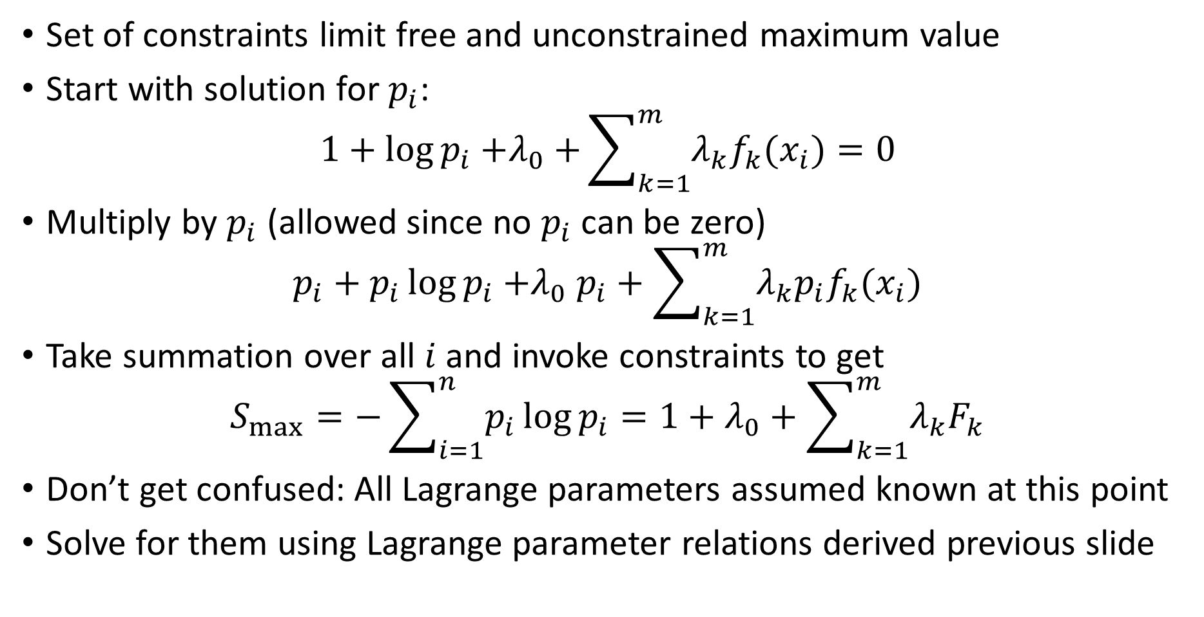
What is the maximum value of the entropy?
Set of constraints limit free and unconstrained maximum value
Start with solution for $p_{i}$:
$$1+\log{p_{i}}{+λ}_{0}+\sum_{k=1}^{m}{λ_{k}f_{k}(x_{i})}=0$$
Multiply by $p_{i}$ (allowed since no $p_{i}$ can be zero)
$$p_{i}+p_{i}\log{p_{i}}{+λ}_{0}p_{i}+\sum_{k=1}^{m}{λ_{k}p_{i}f_{k}(x_{i})}$$
Take summation over all $i$ and invoke constraints to get
$$S_{max}=−\sum_{i=1}^{n}{p_{i}\log{p_{i}}}=1+λ_{0}+\sum_{k=1}^{m}{λ_{k}F_{k}}$$
Don’t get confused: All Lagrange parameters assumed known at this point
Solve for them using Lagrange parameter relations derived previous slide

Slide 9
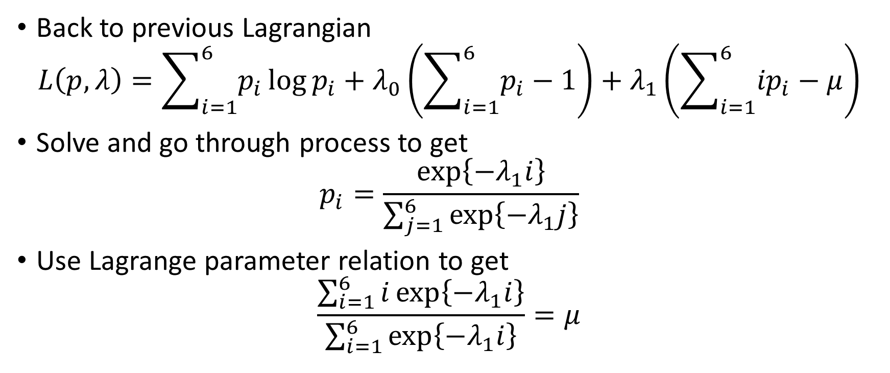
Back to Simple Example
Back to previous Lagrangian
$$L\left(p,λ\right)=\sum_{i=1}^{6}{p_{i}}\log{p_{i}}+λ_{0}\left(\sum_{i=1}^{6}{p_{i}}−1\right)+λ_{1}\left(\sum_{i=1}^{6}{{ip}_{i}}−μ\right)$$
Solve and go through process to get
$$p_{i}=\frac{\exp\left\{−λ_{1}i\right\}}{\sum_{j=1}^{6}{\exp\left\{−λ_{1}j\right\}}}$$
Use Lagrange parameter relation to get
$$\frac{\sum_{i=1}^{6}{i\exp\left\{−λ_{1}i\right\}}}{\sum_{i=1}^{6}{\exp\left\{−λ_{1}i\right\}}}=μ$$

Slide 10
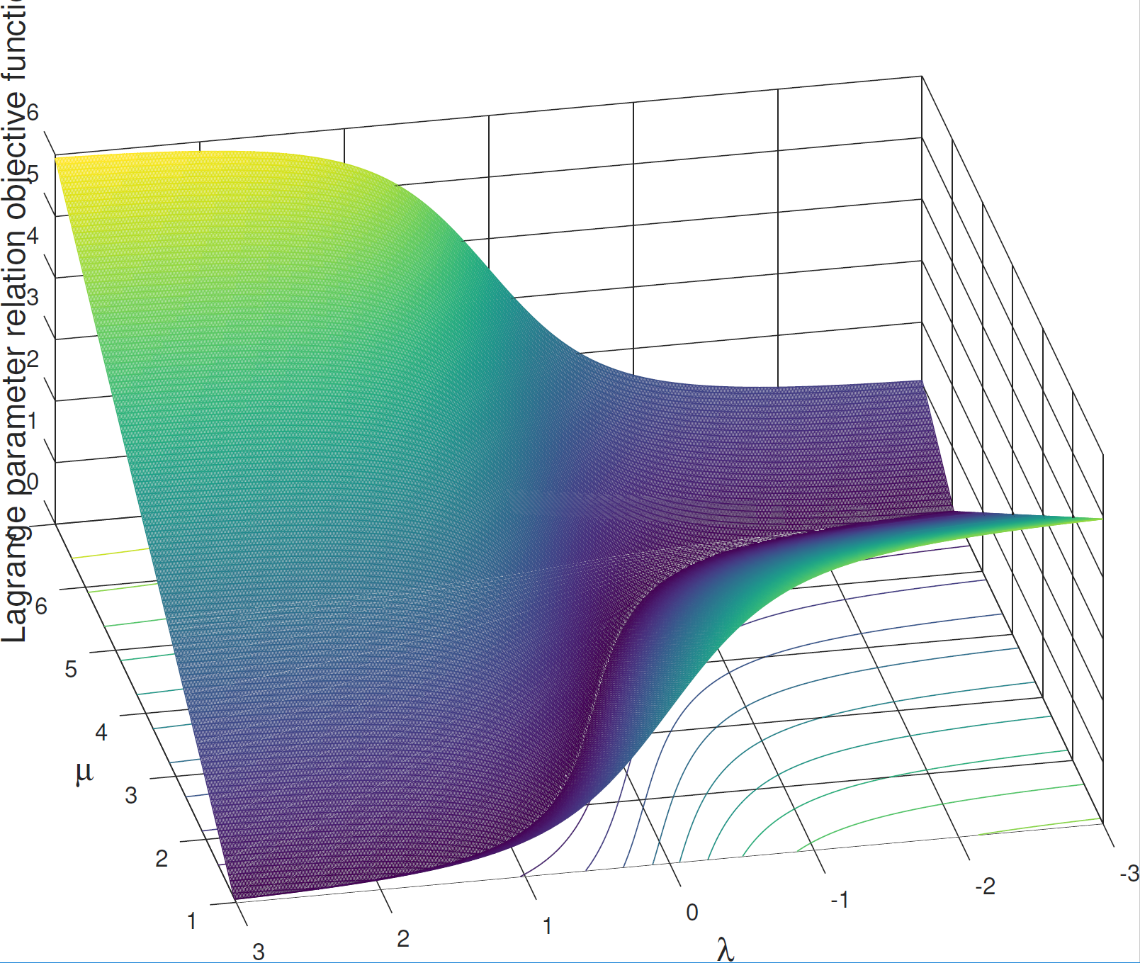
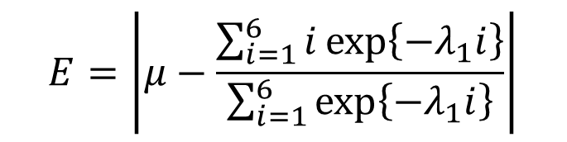
Objective Function for Lagrange Parameter Plots
$$E=\left|μ−\frac{\sum_{i=1}^{6}{i\exp\left\{−λ_{1}i\right\}}}{\sum_{i=1}^{6}{\exp\left\{−λ_{1}i\right\}}}\right|$$

Slide 11
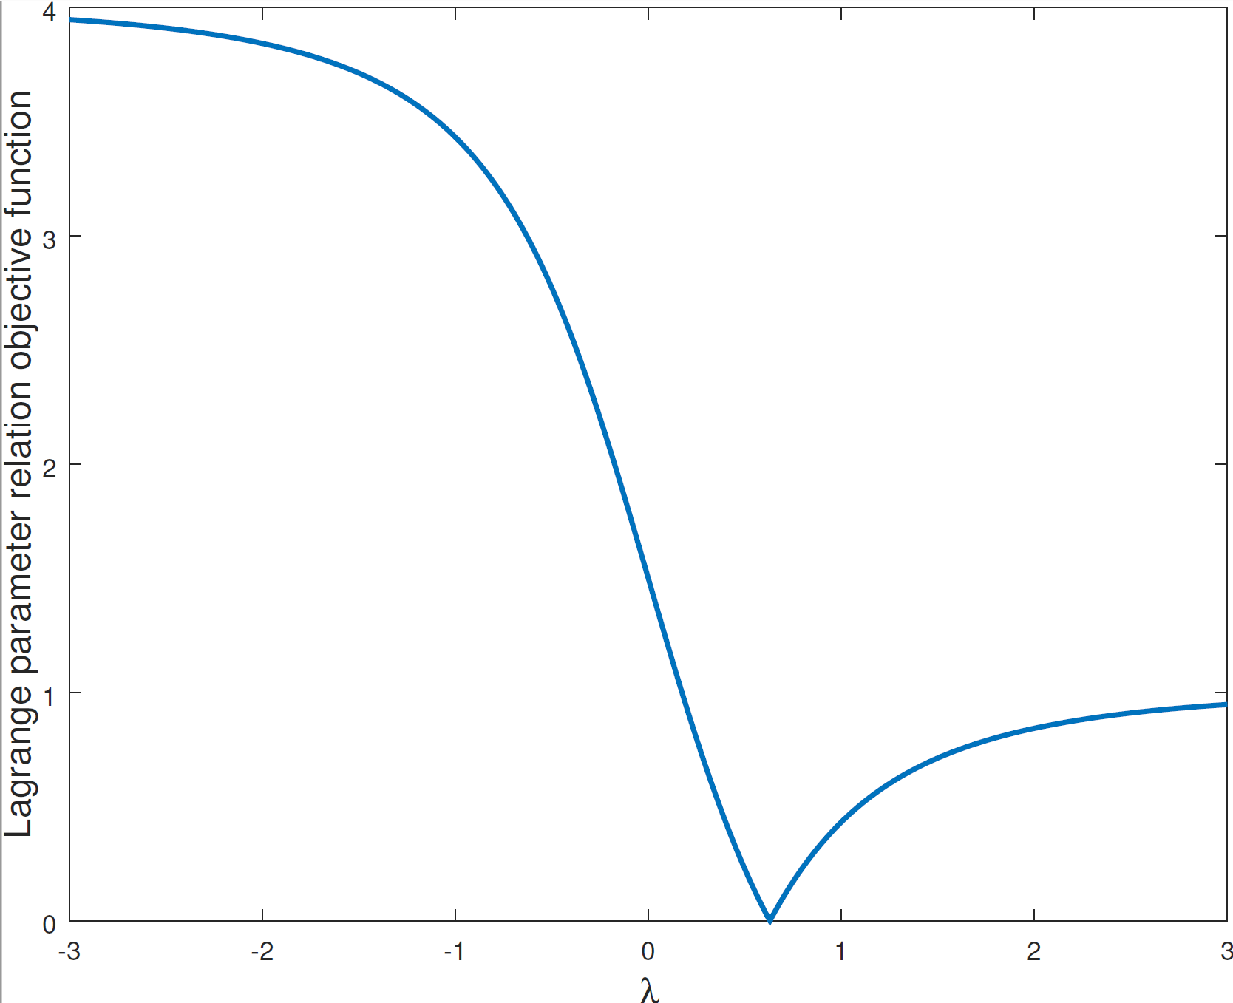
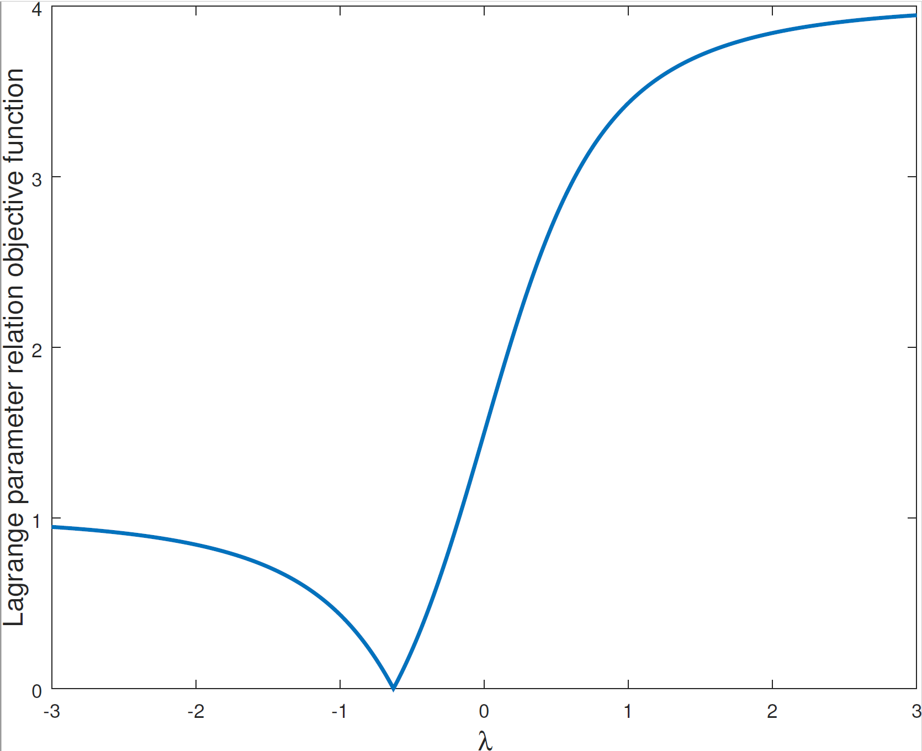


Objective Function for Lagrange Parameter Plots
$$μ=2$$
$$μ=5$$

Slide 12
Summary
Discrete distributions
Maximize entropy subject to expected value constraints
Use averages from experiments to set expected values (Controversy)
Stirling’s approximation for entropy
Constraints expressed using Lagrange parameters
Eliminate probabilities
Re-express Lagrange parameter relations and numerically solve
Maximum entropy subject to constraints has nice form

